Slide 1
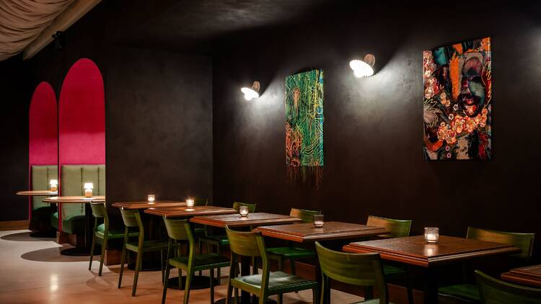

Presented by Maria Rodriquez

Slide 2
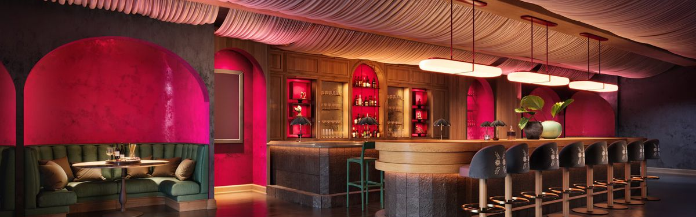

Bar Brief
“Bar” is a sophisticated offering that appeals to both those with distinguished palettes as well as the novice. It’s a space where modern & tradition converge. Bar will honor Jesus’ Mexican heritage, culture and the individuals who have help shape him. The team of bartenders consists of thoughtful taste makers with a passion for spirit driven experiences that give way to memorable hospitality. Agave is celebrated as experts curate a creative and polished experience. The menu is made up of ingredients and techniques that reflect an appreciation for progressive Mexican Cocktails and Spirits.

Slide 3
Mission
01
Celebrate Cultural Heritage
The Hyde Park area is a collective of cultures and people groups. “Bar” will enfold hispanic heritage into the neighborhood and community through food & beverages.
02
Embody "Chido"
“Bar” will be a place that attracts both young professionals as well as mature established locals with an inviting atmosphere to relax, enjoy, be engaged and most importantly have fun.
03
Build Community
The Hispanic idea of community revolves around food and drinks enjoyed together. The heart of bar is to come together, enjoy life together, and build friendships over good food and drinks.

Slide 4
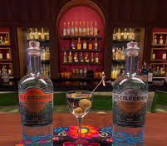
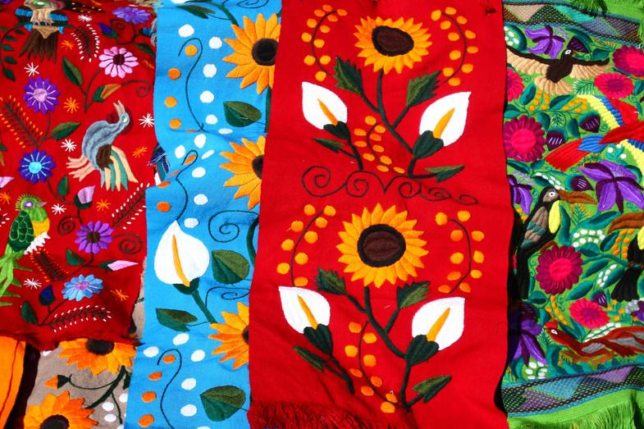
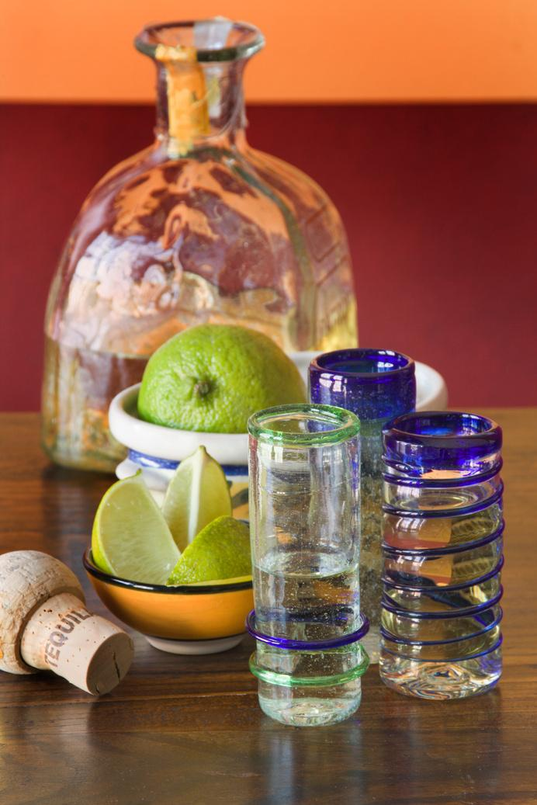
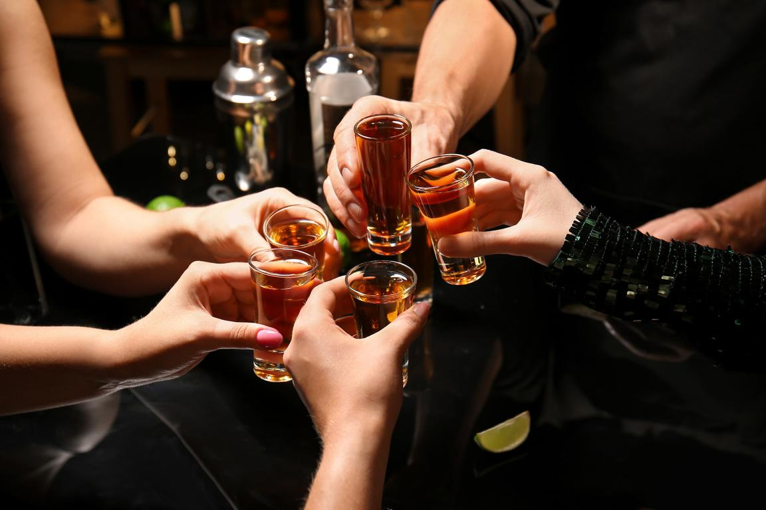
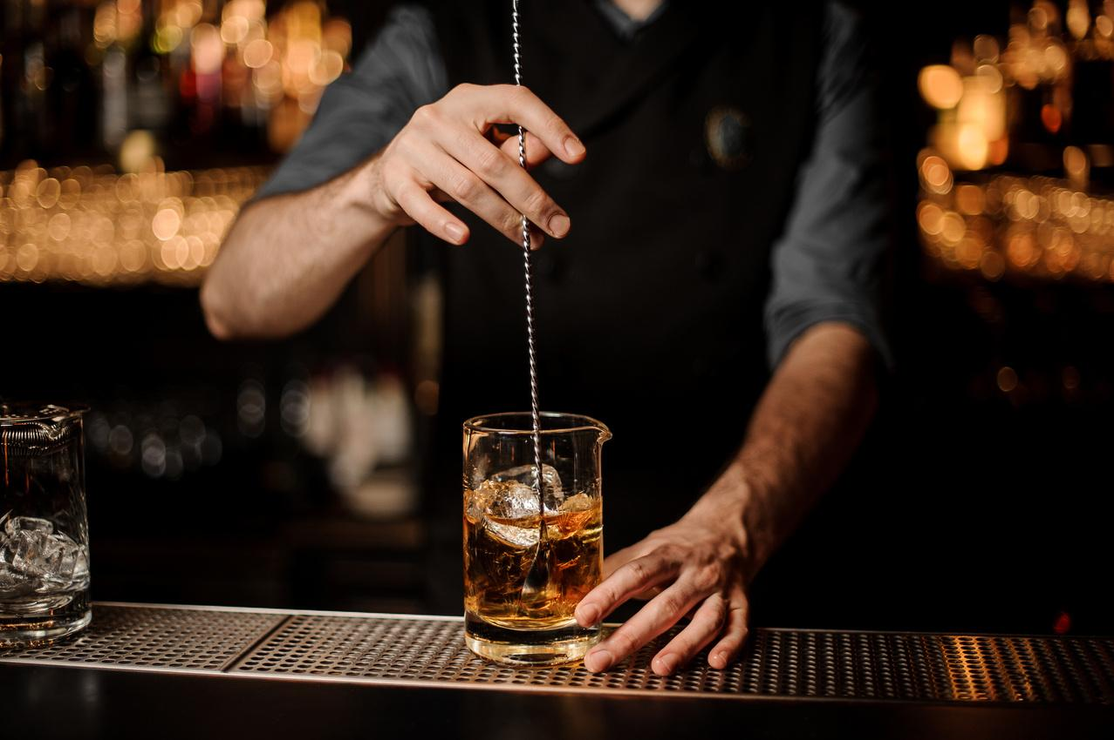
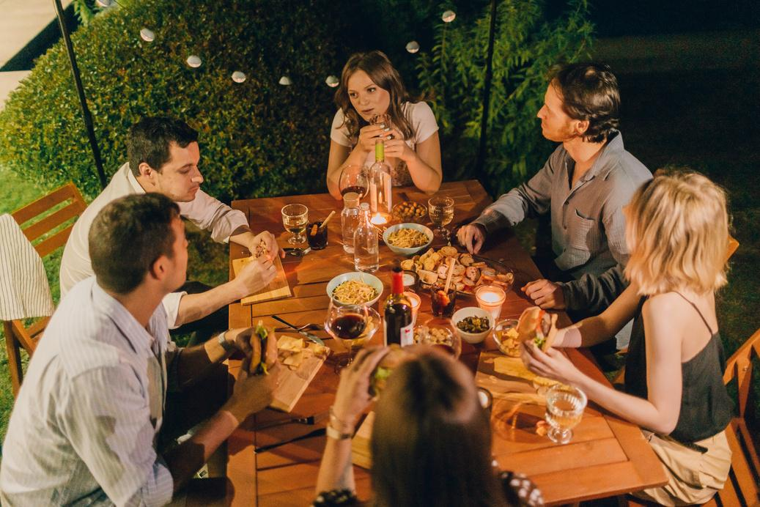
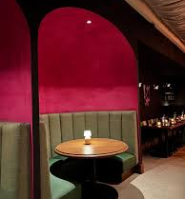
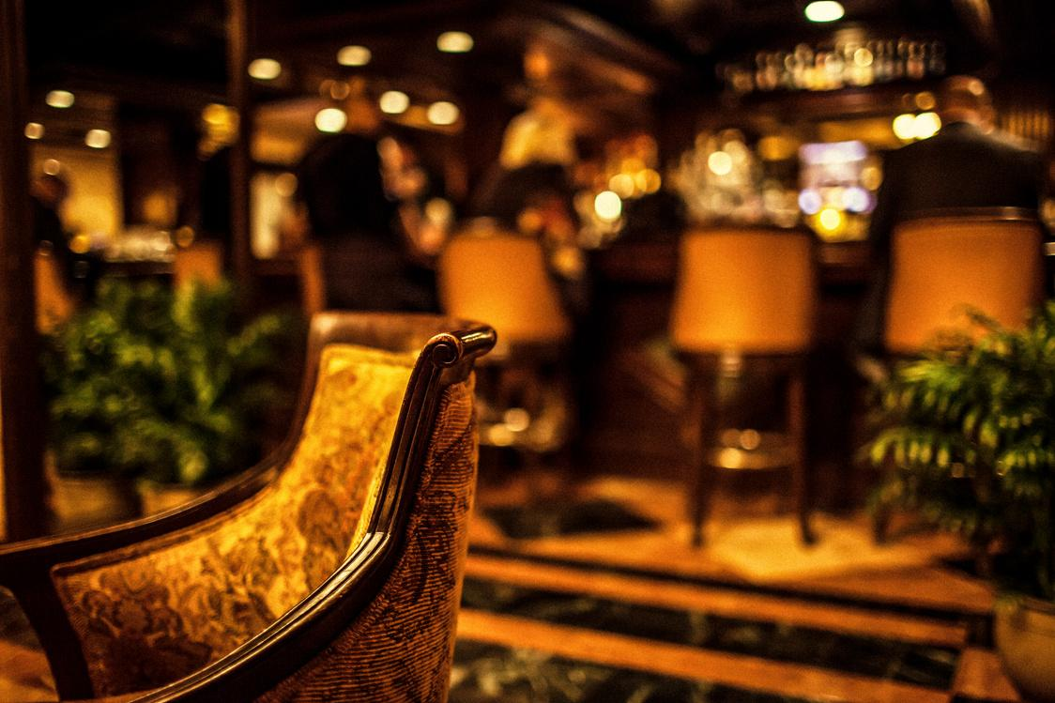
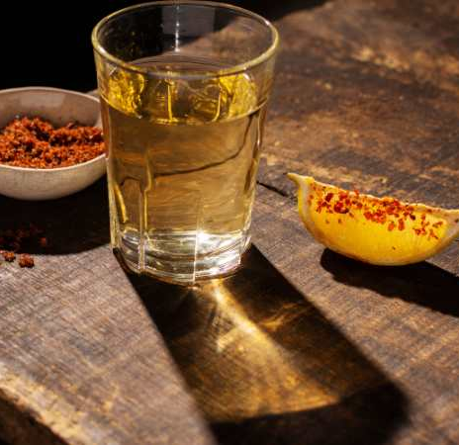
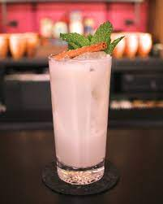
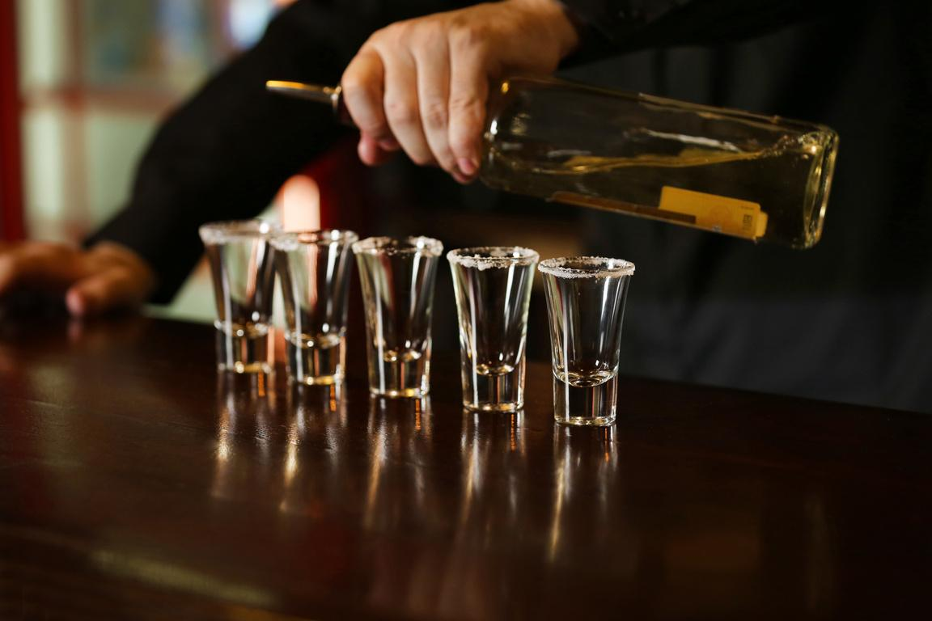
Atmosphere
The Vibe
“Bar” is at its core is a sophisticated Tequila Bar with rare Mescals, thoughtfully crafted small plates and an atmosphere to match. Art installations, pottery, comfortable seating and both small and generous tables to accommodate intimate rendezvous and smaller groups of colleagues, close friends and family.
In a latter phase:
A small outdoor patio reminiscent of the courtyards in Spanish homes provides an extension of the interior space to enjoy the open air when the weather is favorable.
.....

Slide 5

Erick WIlliams
Partner
It is with inimitable persistence, passion and drive to propel today’s dining experience that Erick Williams – Owner and Chef at Virtue Restaurant & Hospitality – has carved a special niche in the restaurant industry.
Opened in November 2018, Virtue was Williams’ first solo concept, and is nestled in the heart of the historic Hyde Park neighborhood, located on Chicago’s south side. The restaurant, which attracts guests both from throughout Chicagoland and around the globe, unites his 25 years of fine dining expertise, his love of Southern cuisine and his insatiable study of history and art as they relate to food culture.
A Chicago native with a formidable career, Williams’ foray and eventual establishment in the culinary scene began at MK The Restaurant working alongside admired chef Michael Kornick. His home for nearly two decades, Williams held the position of Executive Chef at mk, where he was extolled for his farm-to-fork, seasonal approach. During his tenure, the restaurant amassed fiercely loyal patronage while consistently receiving accolades from coast to coast.
The expertise Williams built over the years is reflected at Virtue with his precise sense of timing, immaculate presentation, deeply considered menu and a mantra of leading every guest experience with kindness.

Slide 6

Maria Rodriguez
Head Bartender
Maria journey in hospitality is a testament to resilience, creativity, and passion. Starting as a food runner at Virtue Restaurant, she steadily worked her way up, excelling as an expediter before discovering her true calling behind the bar. Her talent and drive quickly stood out, earning her a bartender role at Virtue, where she refined her craft and developed a unique approach to Southern-inspired cocktails.
Over the past two years, Maria has been instrumental in designing innovative cocktail menus, collaborating with the Virtue bar team to blend technical expertise with a deep love for storytelling. Now, as Head Bartender at Cantina Rosa, Maria brings her creativity full circle by honoring her parents’ Mexican heritage. Her agave-forward and non-alcoholic creations pay tribute to tradition while daring to reimagine it, capturing the essence of her roots in every glass.
Maria draws inspiration from her father’s career in band promotions, which exposed her to the vibrant energy of nightlife and hospitality. Despite growing up in a home with minimal alcohol, she developed a fascination with the craft of cocktails and the transformative experiences they create.
At Cantina Rosa, Maria’s mission is clear: to craft drinks that allow guests to momentarily escape, find joy, and feel truly cared for. She is driven by a vision of hospitality that connects people through shared moments, and she sees her role not just as a bartender but as someone who creates spaces of comfort and connection. Looking ahead, Maria is committed to shaping the industry with her passion for service, storytelling, and her unwavering dedication to celebrating culture through cocktails.

Slide 7
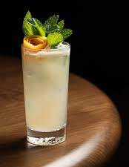
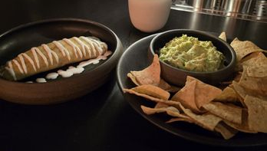
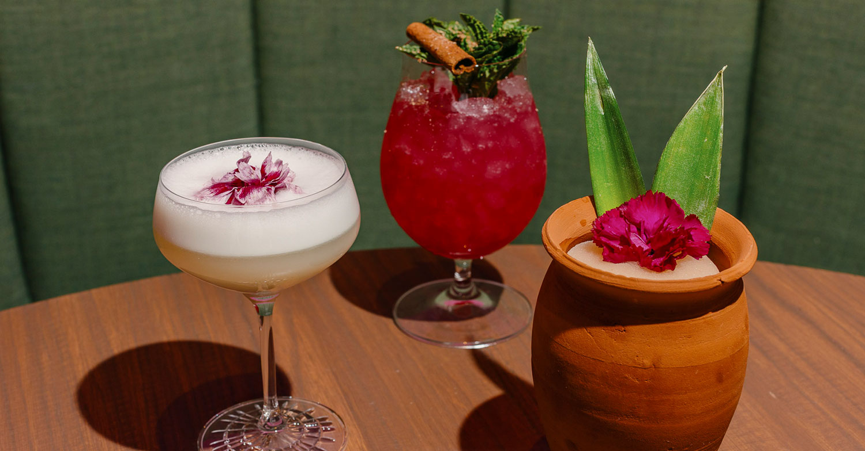
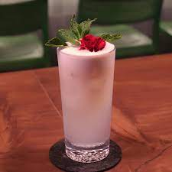
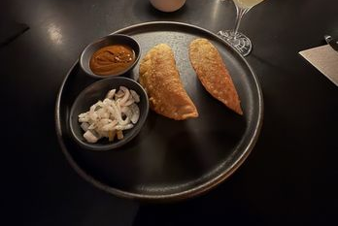
Drinks & Food
Rare Selections, Cocktails & Small Plates
The Bar's Drink Selection is paired with a variety of small plates to satisfy guests while they enjoy their beverages. Possibilities include Handmade Tamales, or empanadas simply dressed tacos, fresh salsas, and street food revised to allow guest to experience a taste of the hispanic food culture.
Paired offerings may also be curated during a later phase and will highlight the rare selections and craft a taste experience for guests.

Slide 8
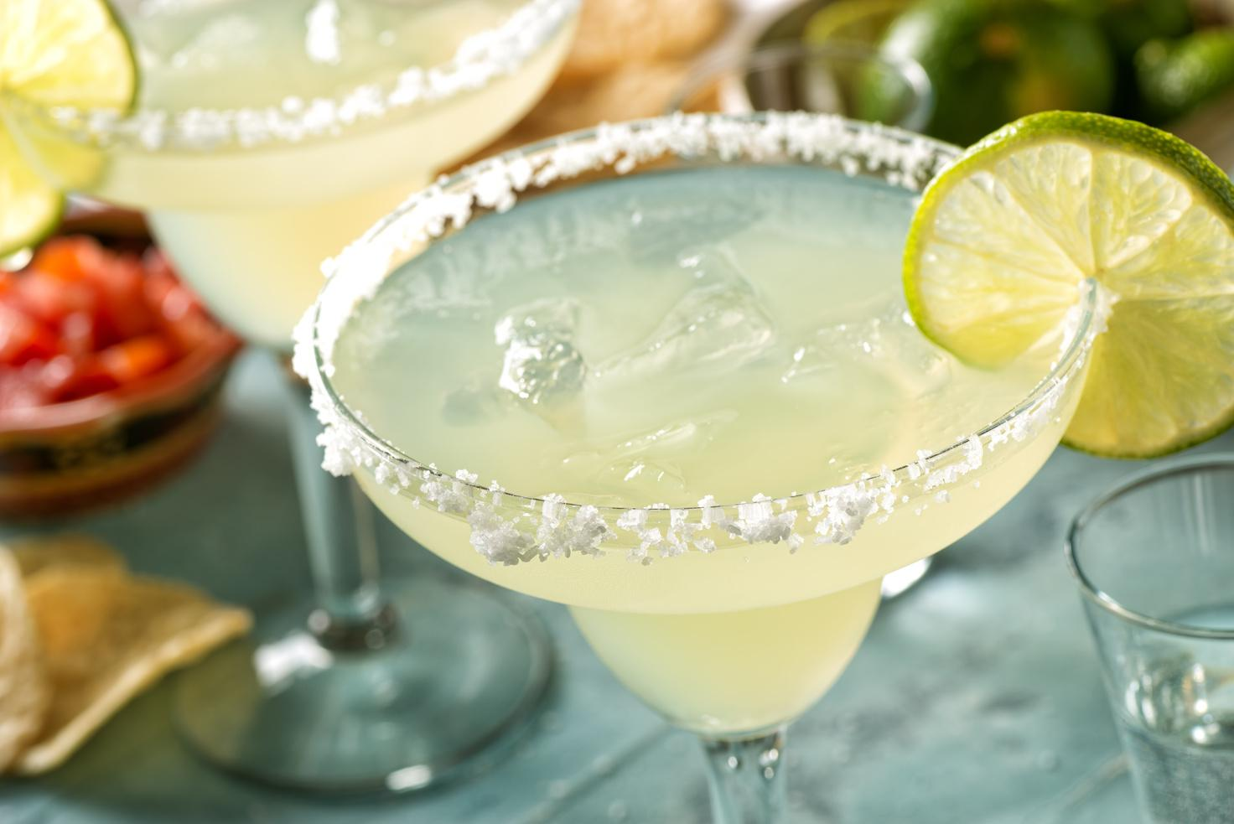
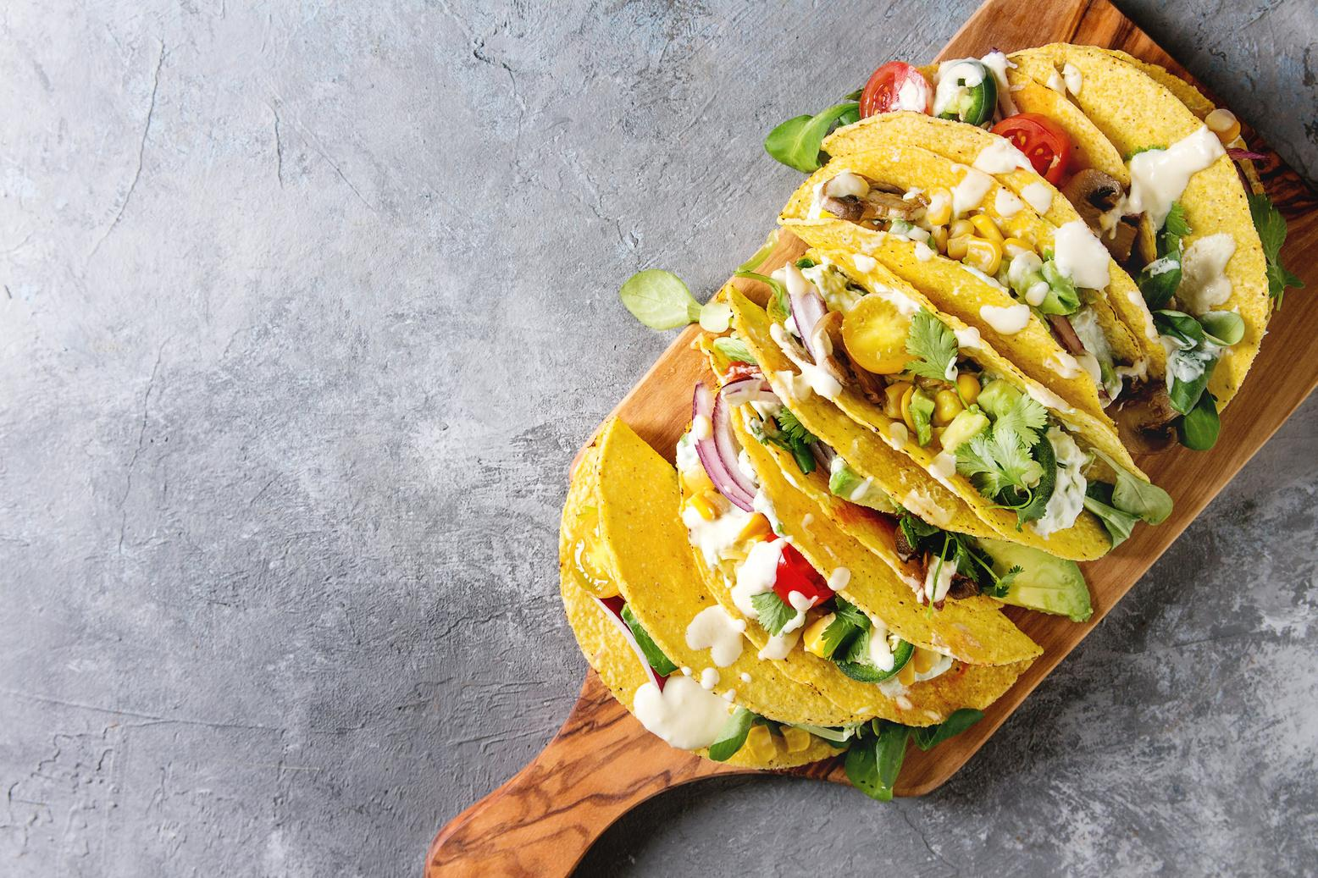
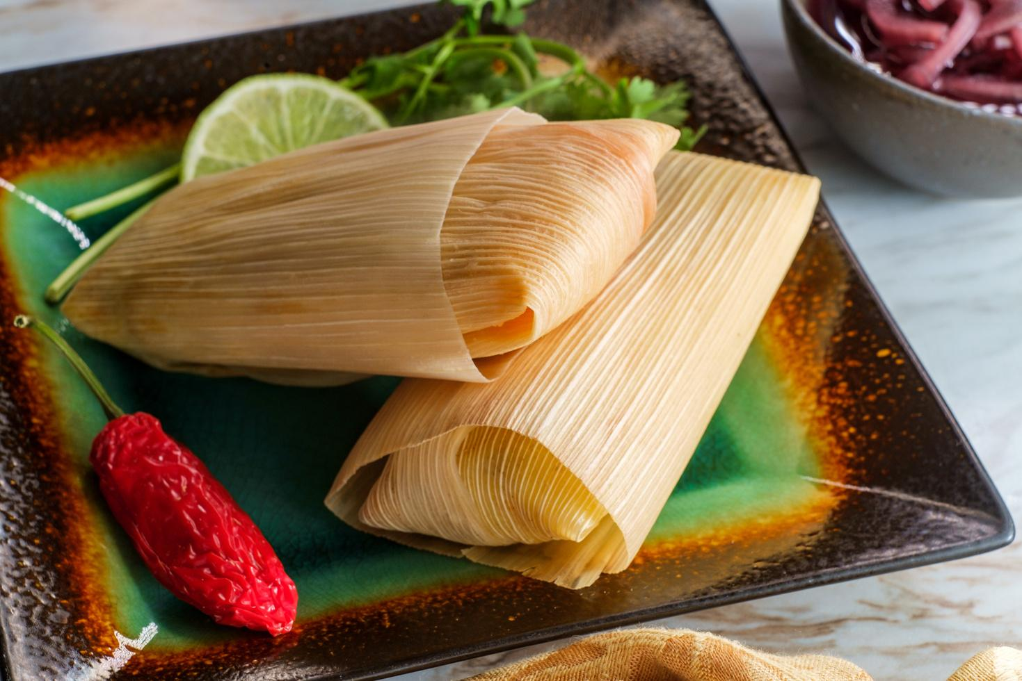
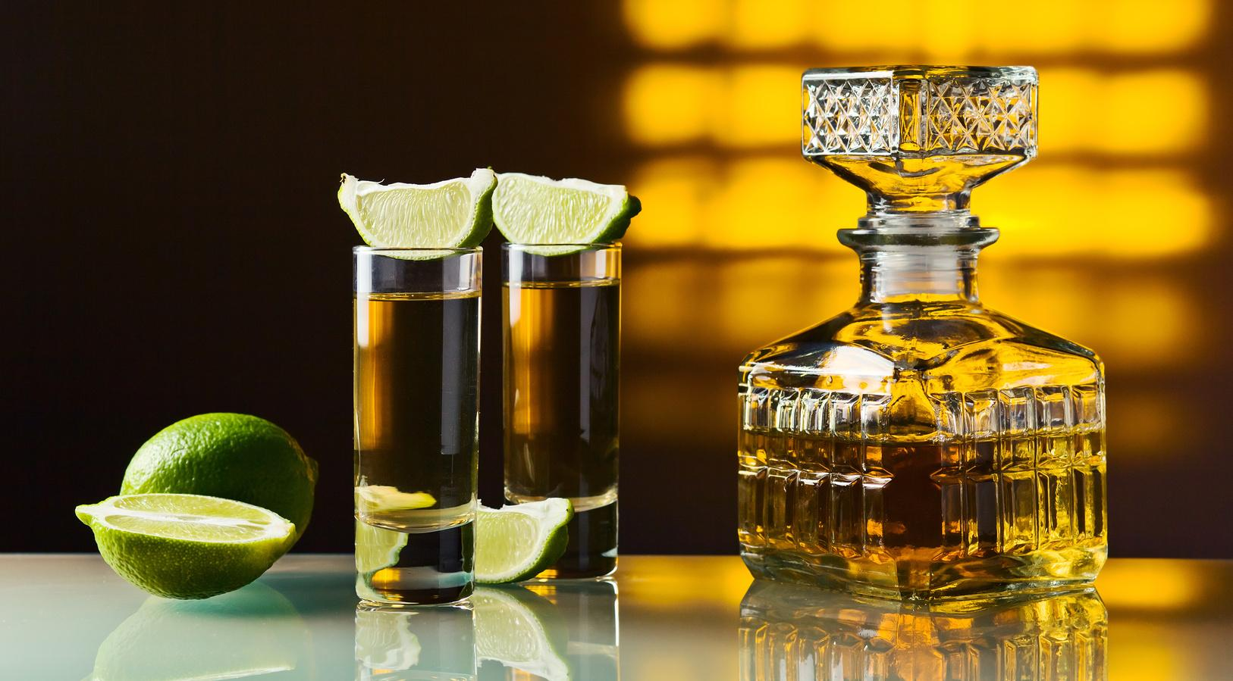
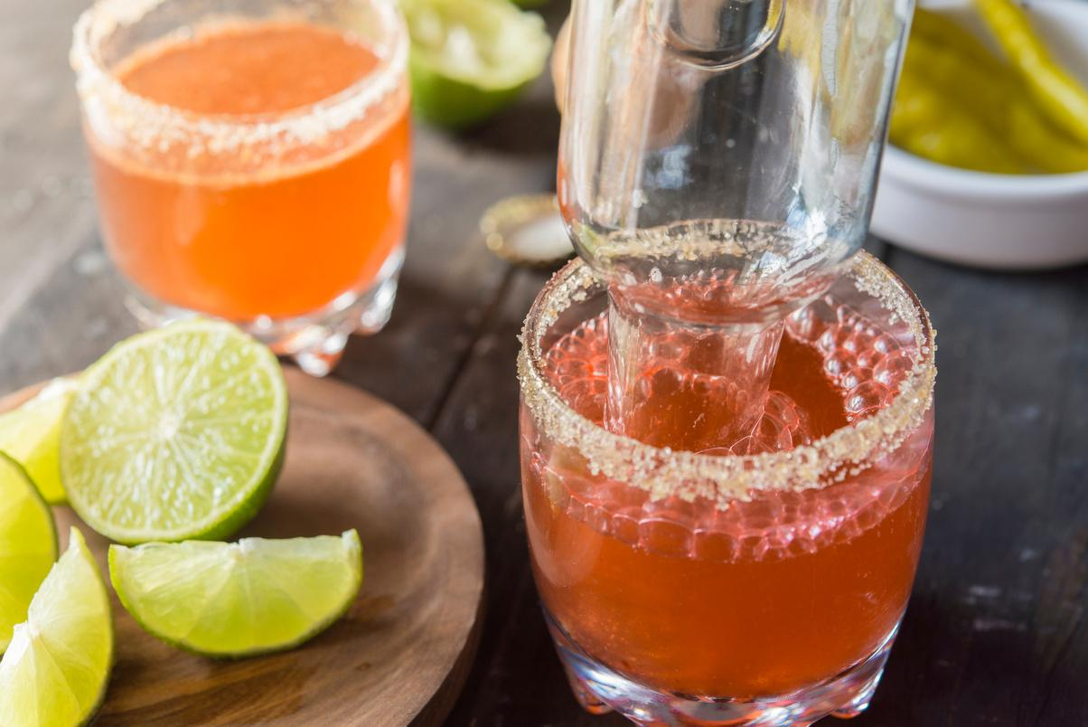
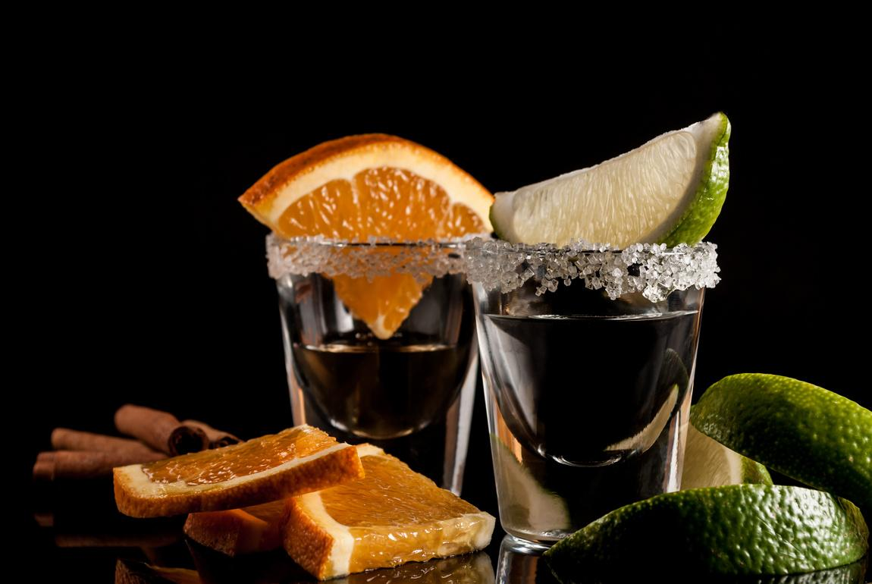
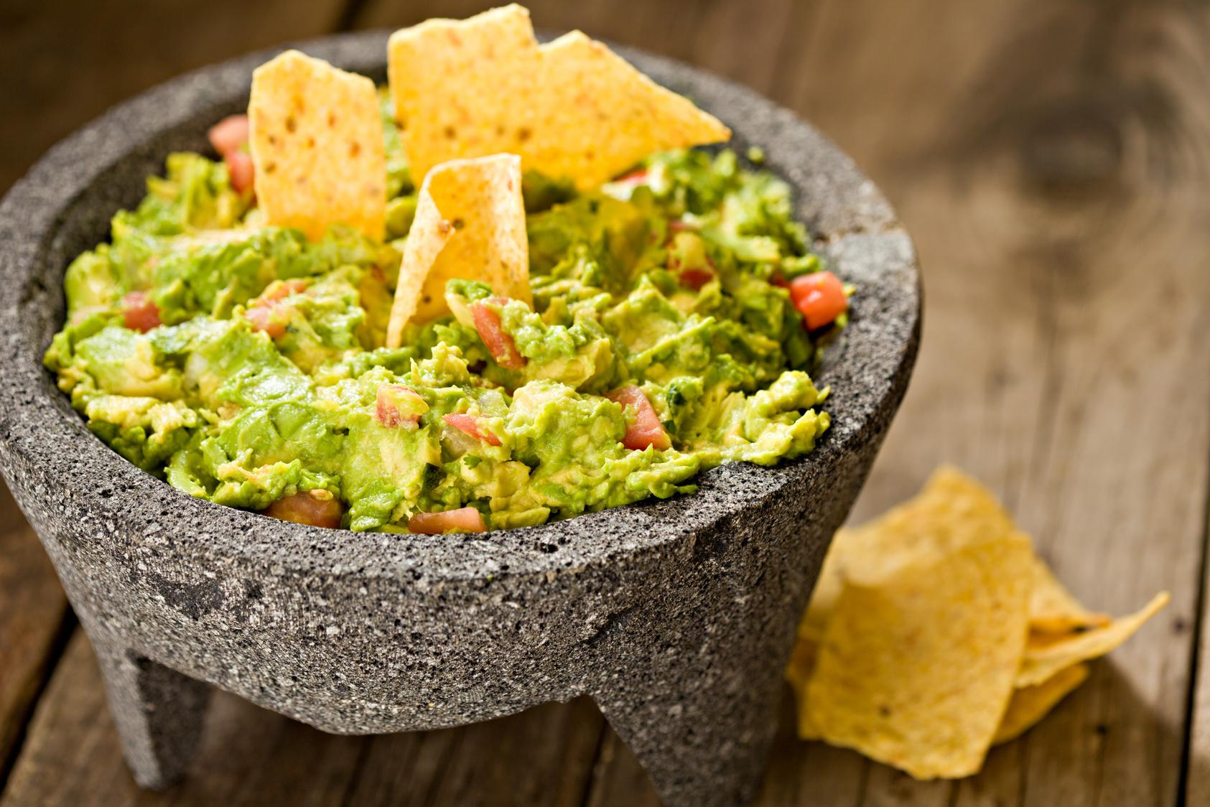
Contact
We look forward to discussing this opportunity with you in more detail please reach out to Erick Williams
at 312.882.7344 or by email at erickcooks@virtuerestaurant.com

Slide 9
Credits:
Interior designer: Erin Boone
Branding & Bar Graphic Design: Nerve collective
Photo credit for Headshots: Huge Galdones

